Slide 1

FUEL PRICE ANALYSIS & PREDICTION
A CASE OF KENYA.

Slide 2
PROJECT OVERVIEW
This project aims to explore the fluctuations in fuel prices across different regions of Kenya between 2016 and 2024.
Through analyzing historical data and building machine learning models, we aim to gain insights into the trends of fuel prices and predict future price movements in various regions of Kenya.
Additionally, we aim to compare the performance of our machine learning models with the model used by the Energy and Petroleum Regulatory Authority (EPRA), the government body responsible for regulating fuel prices in Kenya.
The best-performing machine learning model will be deployed as a web application for real-time fuel price predictions, and a Power BI dashboard will be built to visualize fuel price trends.

Slide 3

PRIMARY OBJECTIVES
Analyze the trends of fuel prices over time (2016-2024)
Compare Fuel Prices Across Different Regions in Kenya
Build Machine Learning Regression Algorithms to Predict Fuel Prices:
Deploy the Best Performing Model as a Web Application for Real-Time Fuel Price Predictions
Compare EPRA's Model Performance Against Our Trained Machine Learning Models.

Slide 4




PROJECT BACKGROUND
Kenya was selected for the purpose of this study based on the following stylized facts:
First, the nominal exchange rate in the country has been increasing, implying macroeconomic challenges. The continued weakening of the Kenya shilling has made the government seek alternatives to reduce pressure on the dollar such as the government-to-government (G-to-G) fuel deal between Kenya and the governments of Saudi Arabia and the United Arab Emirates countries.
Kenya has been unstable over time. In most cases, the upward movement in the price level has exceeded the current government’s inflation target of 5 %.

Slide 5
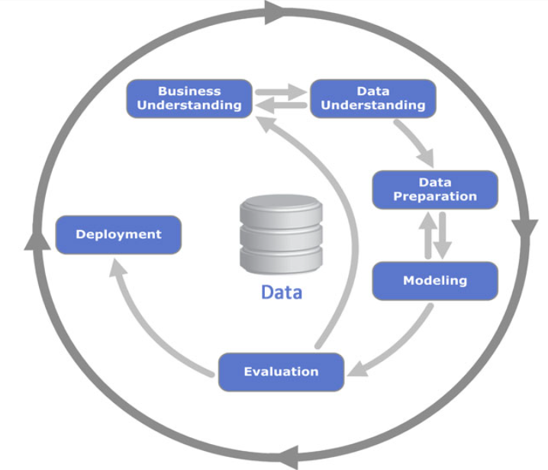
METHODOLOGY
Data Collection and Preparation
Exploratory Data Analysis
Modelling using various ML models
Model Deployment
Comparison with EPRA’S model.

Slide 6
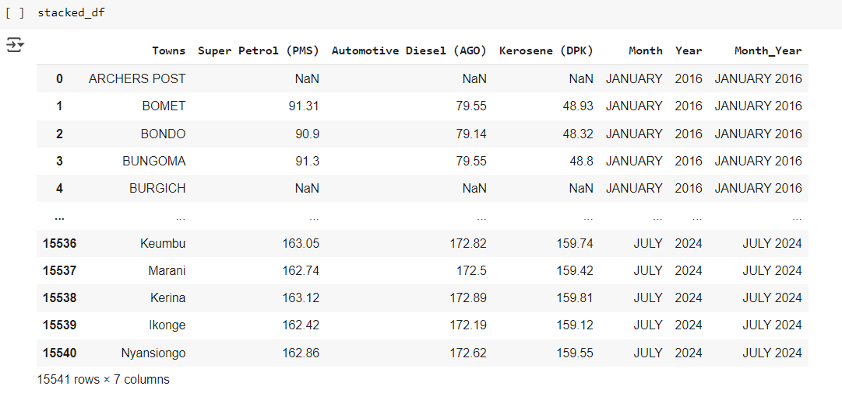
Data Collection & Preparation-Pump Prices
1. Download the Pump Prices excel data files into Colab using gdown library.
2. Load all sheets into a dictionary of dataframes using the pd.read_excel function.
3. Unpivot the data using the following steps:
Drop redundant columns (Fuel Type Diesel, Super Petrol and Kerosene).
Format the dates using’ %b-%y’.
Check for null values which were absent Convert the prices columns from object to numeric type.
The data has multiple sheets for each year 2016-2024. Access the multiple sheets.
5. Drop the county column if it exists.
6. The result is a split dataframe for all years

Slide 7
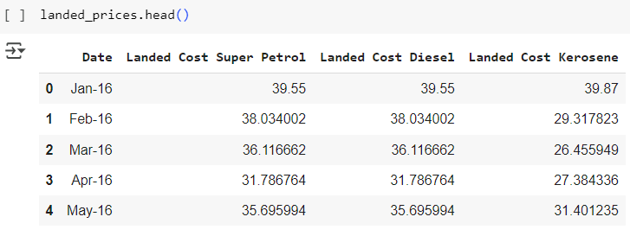

Data Collection & Preparation-Landed Prices
Load the Landed Prices Dataset using pd.read_excel into Colab.
Unpivot the data using the following steps:
Create a list of month and year columns from Jan 2016-Dec 2024
Create a new column to Merge Year and Month
Split the columns based on the pattern for the 3 types of Fuel(PMS, AGO, DMS)
Drop the current index 0 on the current dataframe.
The dataset contained the landing prices of the fuel types categorized as Super Petrol, Kerosene and Diesel.
The final dataset has a shape of (108,4)
Make a copy of the Landed Df to avoid making any changes to the initial dataset.

Slide 8
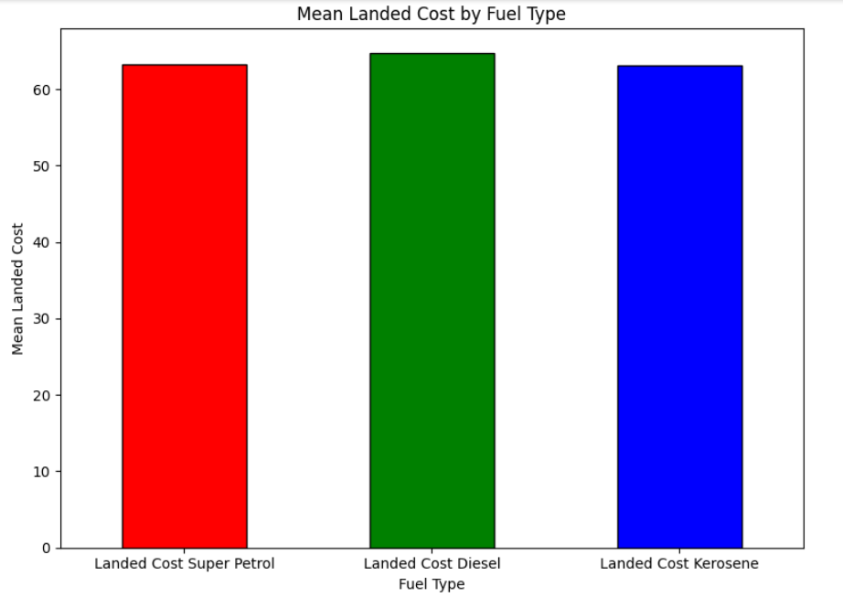
Exploratory Data Analysis
Mean of the Landing Cost per Fuel Type
We calculated the mean and Standard deviation for the fuel landing prices and the results were plotted on a bar plot as shown below:
As shown by the descriptive statistics of the landing cost per fuel type :
Diesel had the highest average landing cost (M = 64.696, SD = 29.778) followed by super petrol (M = 63.240, SD = 27.214) while kerosene had the smallest average landing cost(M = 63.106, SD = 29.853).

Slide 9
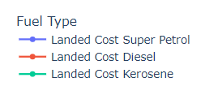
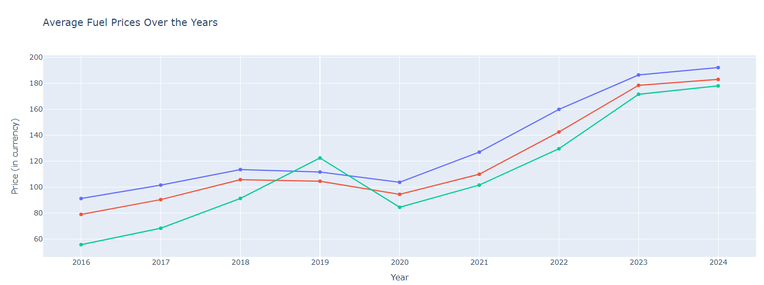
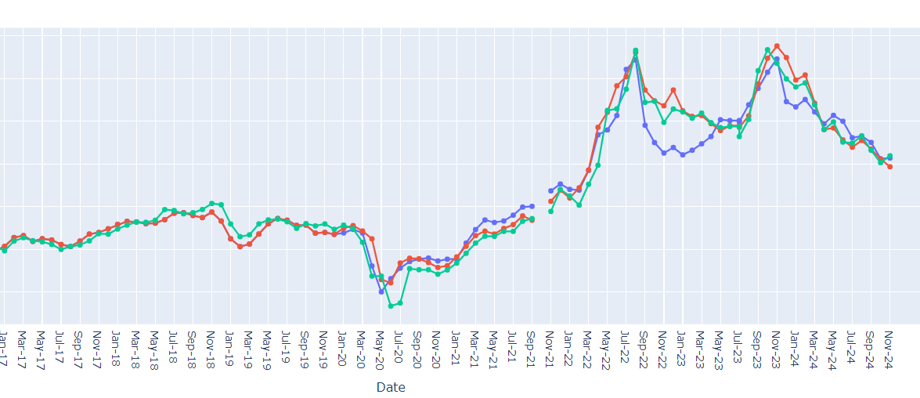
3. Landing cost of Each Fuel Type Over Time
The graph shows a general trend of fluctuation landing costs for all three fuel types over the period. There are periods of significant increases and decreases.
Super Petrol shows the highest volatility, while Kerosene was relatively more stable.
Some possible reasons for the general trend in landed costs could be attributed to domestic factors such as inflation rate, exchange rate dynamics and government factors such as taxation and subsidies.
Further analysis will be carried out to make informed predictions about future fuel costs.
4. Average pump price of each fuel over the years.
Diesel shows a steady increase with a slight dip around 2020. Petrol pumping price displays a more volatile pattern with sharp increase in 2022 and slight decrease in 2024. Kerosene shows a steady increase with a steeper rise in 2022 and 2023.
Global oil process, geopolitical events and supply and demand forces in the market could be attributed to the general trend seen here.
We will analyze correlation with some of these external factors such as inflation rate and exchange rate.

Slide 10
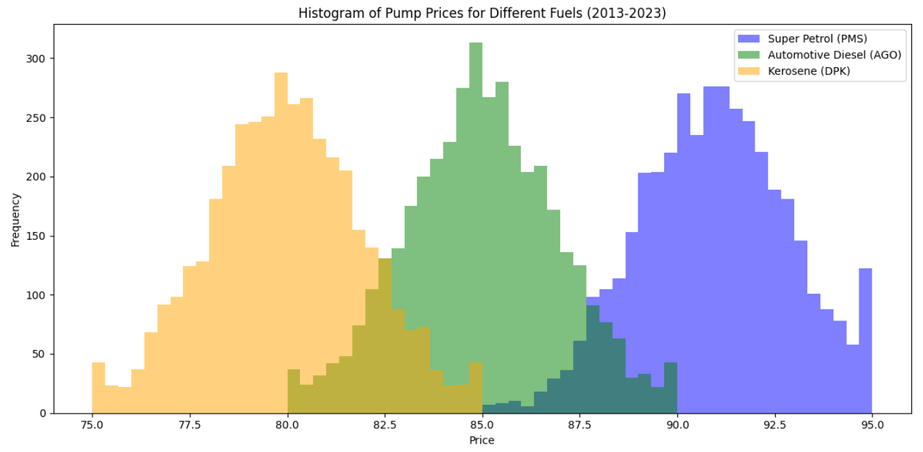
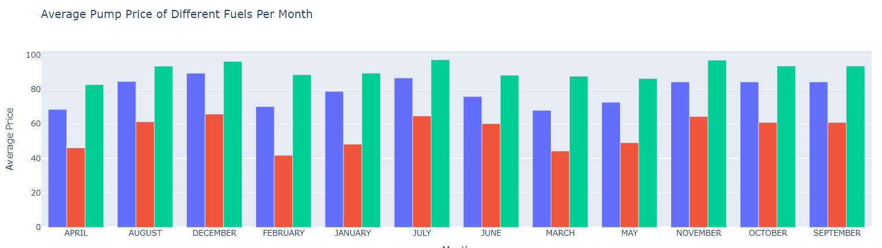
5. Histogram of Pump Prices
As shown by the histogram on the right, each fuel type was seen to have a distinct distribution of prices, with minimal overlap, indicating that their prices tend to cluster around different ranges.
Super Petrol price is centered around KES 92 with a light skewness to the right. The diesel pump prices was seen to be centered around KES 85 indicating the prices is slightly cheaper than petrol. Kerosene pump price was centered around 79-80 with the lowest price of all fuels.
Super Petrol exhibits the largest spread (variance) in prices, meaning its price has fluctuated over a wider range compared to the other two fuels. Kerosene has the smallest spread, indicating more stable pricing.
The differences in spread suggest that the price of Super Petrol is more susceptible to external factors (e.g., global oil prices, supply chain disruptions) than Diesel or Kerosene. Kerosene's price appears to be the most stable
The bar plot also shows that Super Petrol had the highest average price across the years as compared to Diesel and Kerosene. This seasonality will be explained in more detail.

Slide 11
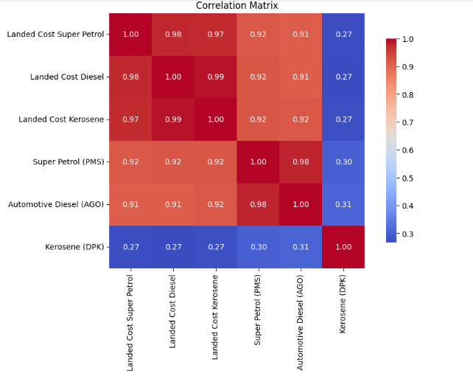
Correlation Matrix of Fuel Prices
The Landed Prices data was merged with the Pump Prices data to create a correlation matrix.
The matrix shows very strong positive correlations between all three fuel types. This suggests that the prices of these fuels tend to move in tandem.
The highest correlations are observed between Super Petrol and Diesel, and between Diesel and Kerosene. This indicates that these two pairs of fuels have the strongest price relationship.
The strong correlations likely reflect the influence of common market factors on fuel prices, such as global oil prices, economic conditions, and government policies.
Changes in supply and demand for one fuel type can often impact the prices of other fuels as well.

Slide 12
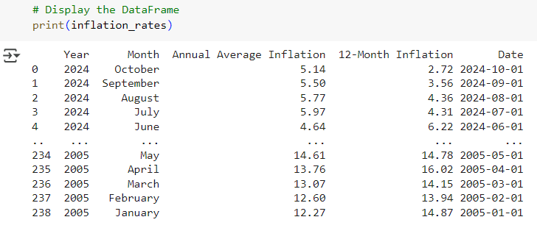
Inflation Rate Change Impact on Fuel Prices
Inflation rate data was imported to analyze the change in inflation rate from 2005-2024 to explain some of the fluctuations in fuel prices as previously observed.
Changes in inflation result in increase in price of goods and services across the economy which can directly affect extraction, refining and transportation costs of fuel resulting in price change.
Inflation also places an upward pressure on demand of goods including fuel as people seek to maximize consumption before prices can further increase.

Slide 13
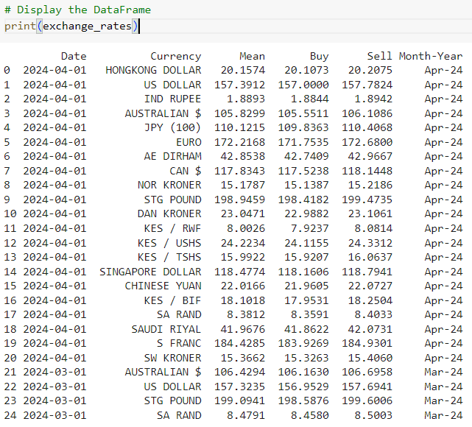
Exchange Rate Impact on Fuel Prices
Exchange rates play a significant role in determining fuel prices, especially in countries that rely heavily on fuel imports like Kenya.
When a country's currency depreciates against the US dollar, it becomes more expensive to import oil. This increased cost is often passed on to consumers in the form of higher fuel prices.
When a domestic currency weakens, it can lead to higher import costs causing increased overall inflation, which further increases the cost of producing and distributing fuel, putting upward pressure on fuel prices.

Slide 14
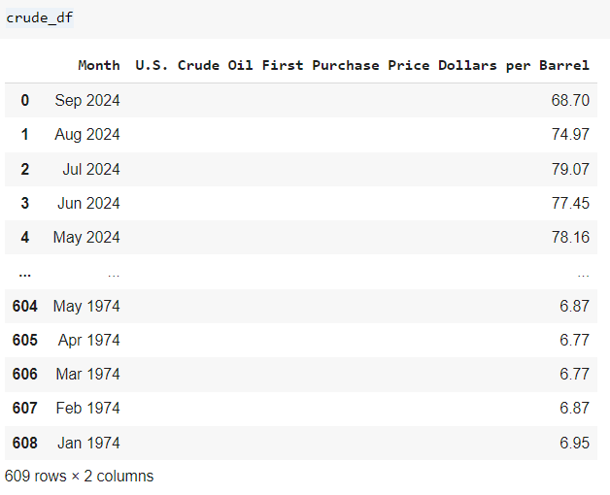
U.S Crude_Oil_First_Purchase_Price
The U.S. is one of the world's largest producers of crude oil. Its market dynamics significantly influence global oil prices. Factors like U.S. production levels, inventory levels, and demand for fuel all contribute to the overall price of crude oil.
The global oil pricing benchmark has a ripple effect on other crude oil benchmarks and, consequently, on fuel prices worldwide.

Slide 15
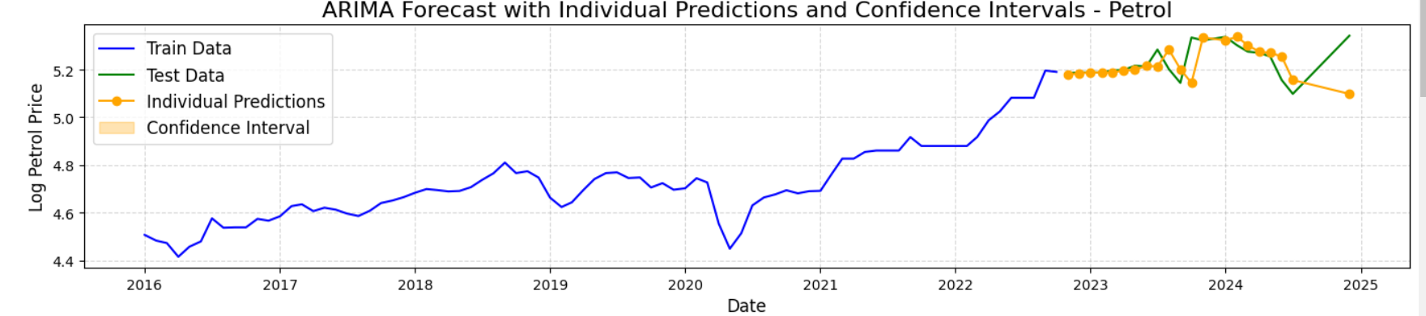
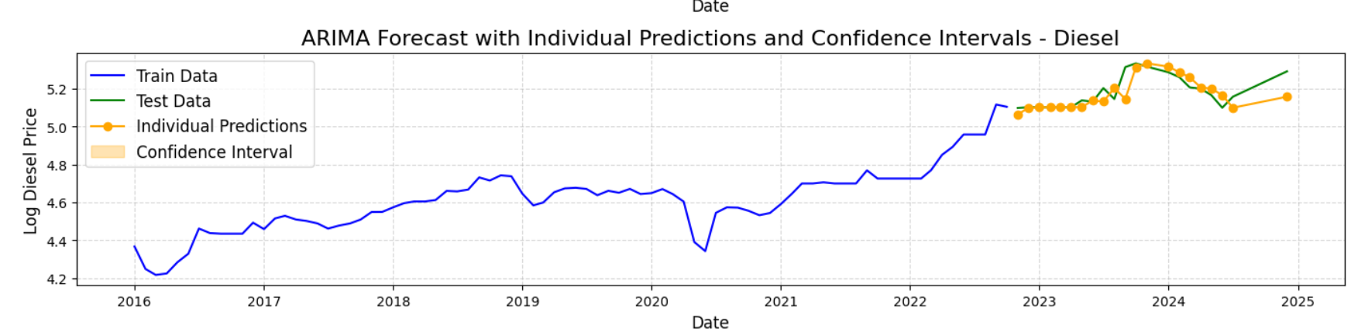
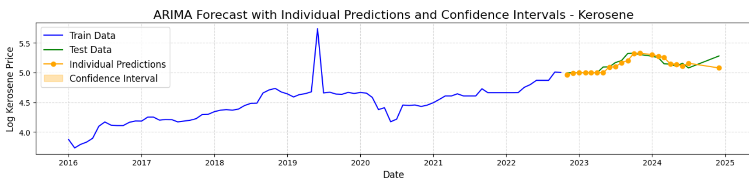
Modeling using ARIMA
Why Arima?
Captures past dependencies and trends in fuel prices.
Model Selection Process:
Used Auto ARIMA to automate parameter selection.
Evaluated models based on Akaike Information Criterion (AIC).
Best Models Identified:
Super Petrol: ARIMA(0,1,1), AIC = -283
Diesel: ARIMA(0,1,2), AIC = -246.04
Kerosene: ARIMA(0,1,1), AIC = -60.507
Model Validation:
Performed residual analysis.
Conducted Ljung-Box test confirming no significant autocorrelation in residuals, indicating a well-fitted model.

Slide 16
Modelling with XgBoost and Random Forest
XGBoost: Boosted Decision Tree-based regression model.
Random Forest: Ensemble model aggregating multiple decision trees.
Feature Engineering:
Used historical fuel prices, inflation rates, exchange rates, and global oil, prices.
Hyperparameter Tuning:
Used GridSearchCV for optimizing model parameters.
Evaluation Metrics:
Mean Squared Error (MSE) and R-squared used to compare model accuracy.
Super Petrol:
ARIMA: MSE = 0.0289
XGBoost: MSE = 0.0050
Random Forest: MSE = 0.0010 (Best)
Diesel:
ARIMA: MSE = 0.0218
XGBoost: MSE = 0.0035 (Best)
Random Forest: MSE = 0.0095
Kerosene:
ARIMA: MSE = 0.0184
XGBoost: MSE = 0.0150
Random Forest: MSE = 0.0057 (Best)

Slide 17
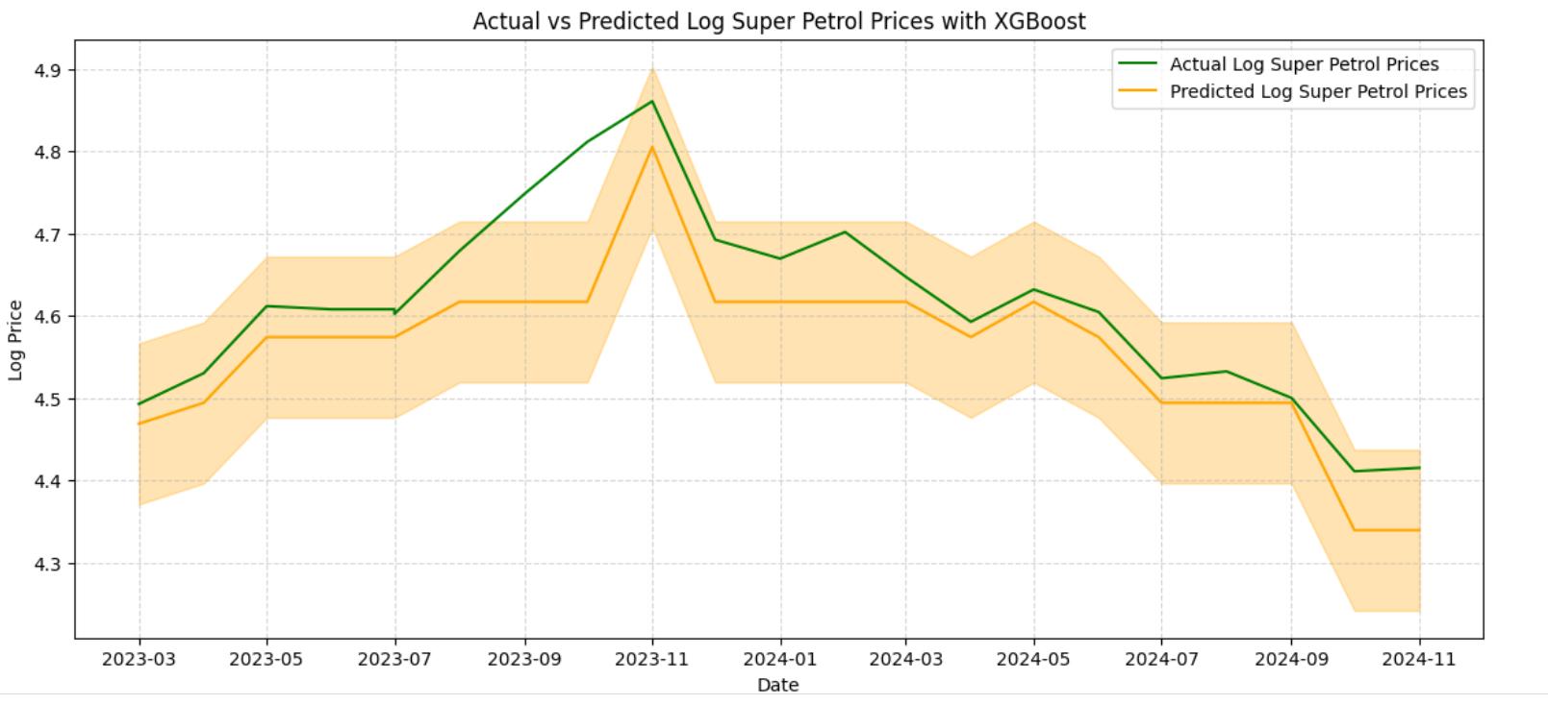
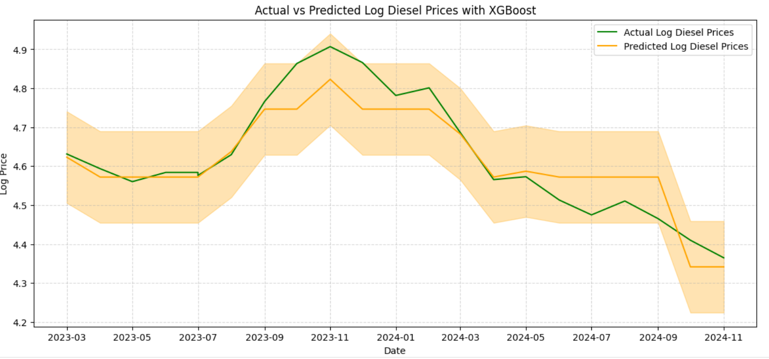
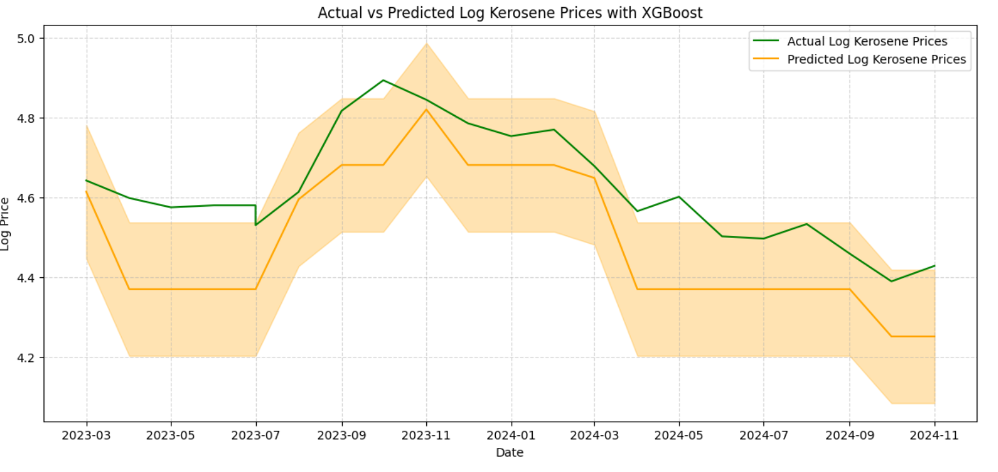
XgBoost Model
The Mean Squared Error (MSE) values for the XGBoost model applied to the pump_prices dataset provide insights into the model's prediction accuracy for each type of fuel.
MSE Super Petrol- 0.004
MSE Diesel - 0.0035
MSE Kerosene - 0.0241.
These low MSE values for Super Petrol and Diesel suggest that the model's predictions are closely aligned with the actual log-transformed pump prices, indicating good performance for these fuel types. However, the higher MSE for Kerosene indicates that the model's predictions for Kerosene prices are less accurate compared to Super Petrol and Diesel.
This discrepancy may be due to higher volatility, seasonal variations, or additional factors influencing Kerosene prices that the model did not capture as effectively.

Slide 18
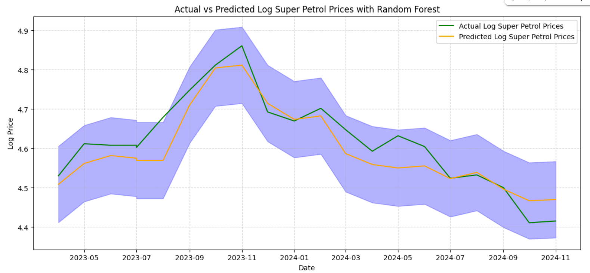
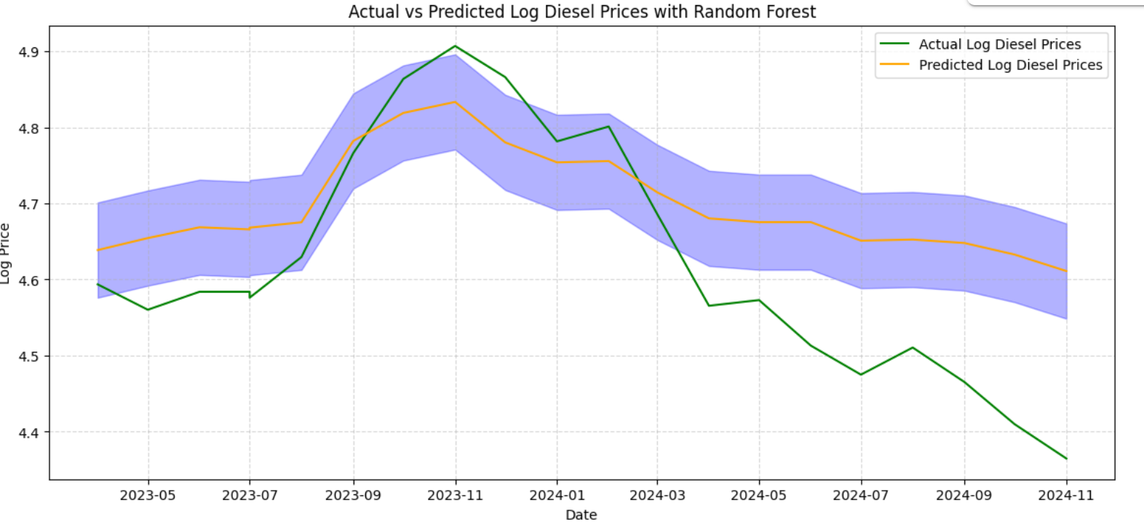
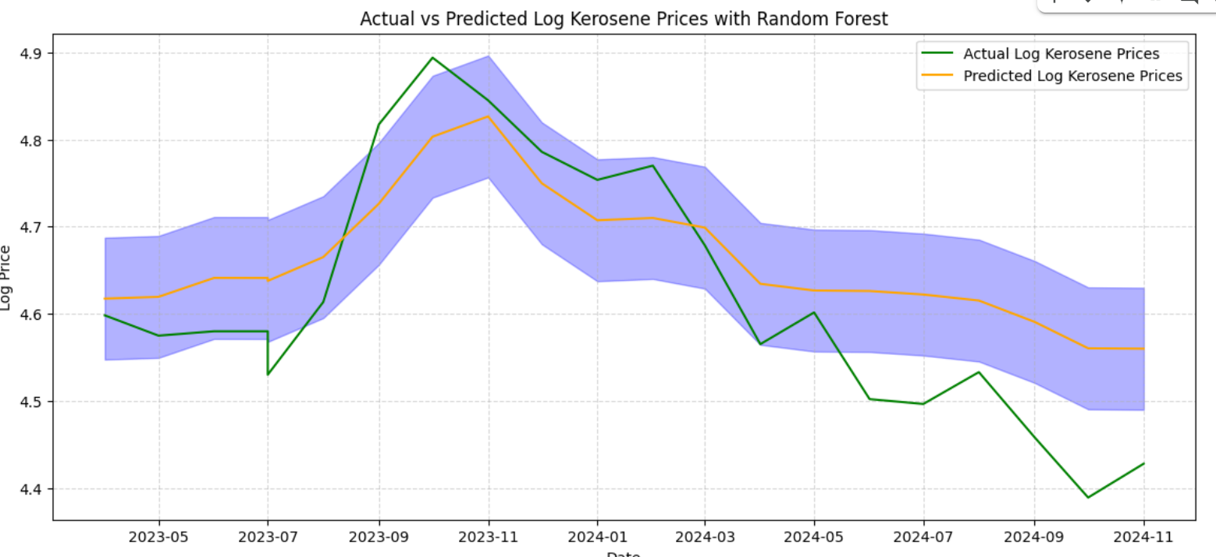
RANDOM REGRESSOR
The Mean Squared Error (MSE) values for the Random Forest model applied to the pump prices dataset provide insights into the model's prediction accuracy for each type of fuel.
The MSE for Super Petrol is 0.0033
Diesel is 0.0175
Kerosene is 0.0108.
These relatively low MSE values for Super Petrol suggest that the model's predictions are quite close to the actual log-transformed pump prices, indicating good performance for Super Petrol.
However, the higher MSE values for Diesel and Kerosene indicate that the model's predictions for these fuel types are less accurate.
This discrepancy may be due to higher volatility, seasonal variations, or additional factors influencing Diesel and Kerosene prices that the model did not capture as effectively.

Slide 19
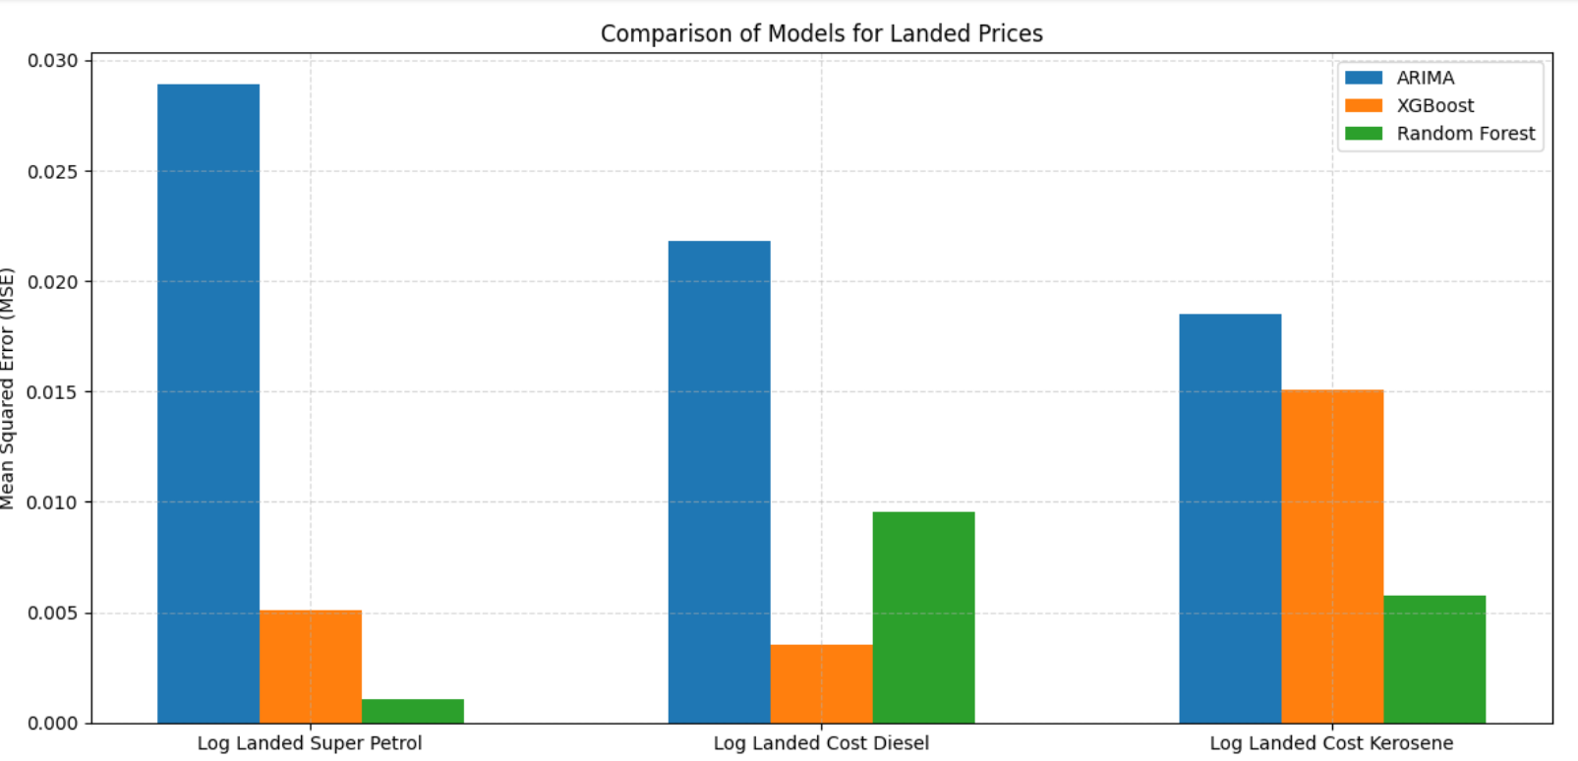
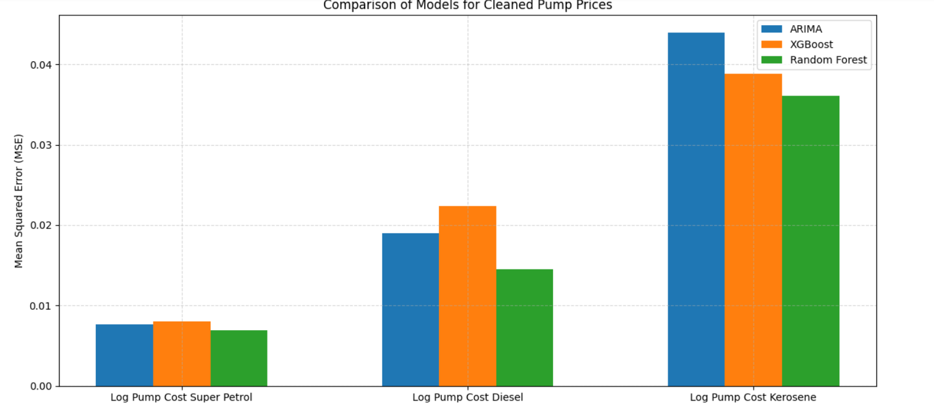
MODEL COMPARISON
Super Petrol:
ARIMA: MSE = 0.0289
XGBoost: MSE = 0.0050
Random Forest: MSE = 0.0010 (Best)
Diesel:
ARIMA: MSE = 0.0218
XGBoost: MSE = 0.0035 (Best)
Random Forest: MSE = 0.0095
Kerosene:
ARIMA: MSE = 0.0184
XGBoost: MSE = 0.0150
Random Forest: MSE = 0.0057 (Best)

Slide 20
Conclusion
As shown by the results and graphs above, the performance of the ARIMA, XGBoost, and Random Forest models varies across the different types of fuel for both the landed_prices and cleaned_pump_prices datasets.
For landed_prices, XGBoost and Random Forest models show significantly lower MSE values compared to ARIMA, indicating better performance for predicting log-transformed prices, especially for Super Petrol and Diesel.
However, Random Forest performs slightly better than XGBoost for Kerosene. For cleaned_pump_prices, Random Forest generally outperforms both ARIMA and XGBoost, with the lowest MSE values for Super Petrol, Diesel, and Kerosene.
Overall, the Random Forest model demonstrates the best performance for both datasets, consistently providing more accurate predictions compared to the other models.

